Slide 1

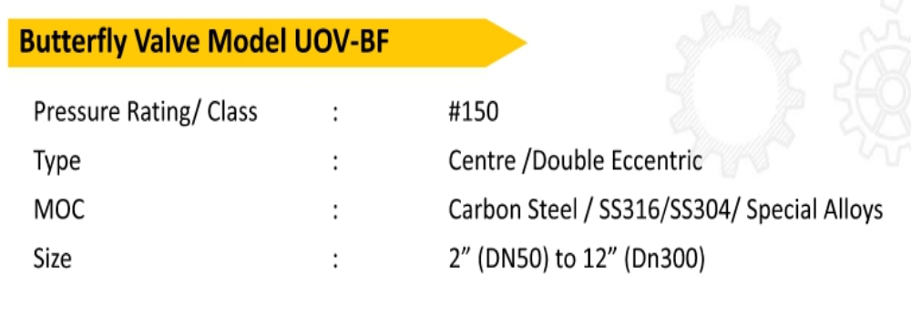
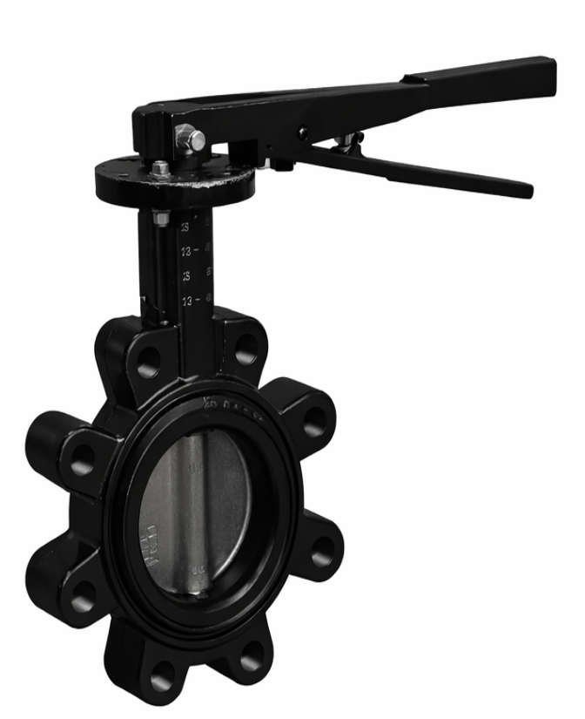
UUNIQE- Butterfly Valve
Model -UOV-BF

